Slide 1
SQL

Slide 2
What is SQL?
SQL is Structured Query Language used for storing, manipulating and retrieving data stored in a database.

Slide 3
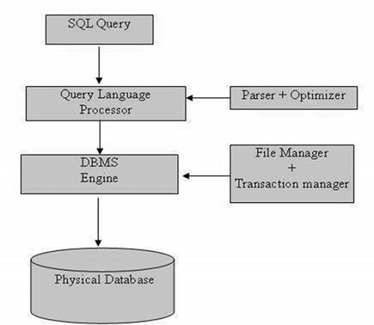
SQL Process

Slide 4
SQL Commands
The standard SQL commands to interact with relational databases are CREATE, SELECT, INSERT, UPDATE, DELETE and DROP

Slide 5
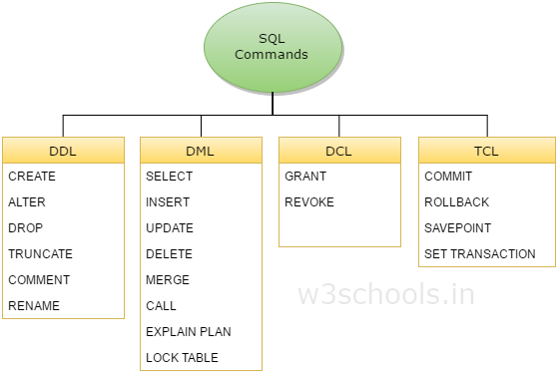

Slide 6
Data Definition Language
Data Definition Language(DDL) deals with database schemas and descriptions, of how the data should reside in the database.
CREATE – to create database and its objects like (table, index, views, store procedure, function and triggers)
ALTER – alters the structure of the existing database
DROP – delete objects from the database
TRUNCATE – remove all records from a table, including all spaces allocated for the records are removed
COMMENT – add comments to the data dictionary
RENAME – rename an object

Slide 7
Data Manipulation Language
Data Manipulation Language(DML) deals with data manipulation, and includes most common SQL statements such SELECT, INSERT, UPDATE, DELETE etc, and it is used to store, modify, retrieve, delete and update data in database.
SELECT – retrieve data from the a database
INSERT – insert data into a table
UPDATE – updates existing data within a table
DELETE – Delete all records from a database table
MERGE – UPSERT operation (insert or update)
CALL – call a PL/SQL or Java subprogram
EXPLAIN PLAN – interpretation of the data access path
LOCK TABLE – concurrency Control

Slide 8
DCL
DCL is short name of Data Control Language which includes commands such as GRANT, and mostly concerned with rights, permissions and other controls of the database system.
GRANT – allow users access privileges to database
REVOKE – withdraw users access privileges given by using the GRANT command

Slide 9
TCL
TCL is short name of Transaction Control Language which deals with transaction within a database.
COMMIT – commits a Transaction
ROLLBACK – rollback a transaction in case of any error occurs
SAVEPOINT – to rollback the transaction making points within groups
SET TRANSACTION – specify characteristics for the transaction

Slide 10
DDL - Data Definition Language
Sr.No. | Command & Description
1 | CREATE Creates a new table, a view of a table, or other object in the database.
2 | ALTER Modifies an existing database object, such as a table.
3 | DROP Deletes an entire table, a view of a table or other objects in the database.

Slide 11
DML - Data Manipulation Language
Sr.No. | Command & Description
1 | SELECT Retrieves certain records from one or more tables.
2 | INSERT Creates a record.
3 | UPDATE Modifies records.
4 | DELETE Deletes records.

Slide 12
DCL - Data Control Language
Sr.No. | Command & Description
1 | GRANT Gives a privilege to user.
2 | REVOKE Takes back privileges granted from user.

Slide 13
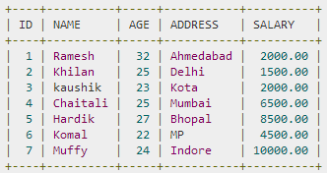
What is a table?
Field
Row
Colum

Slide 14
SQL Constraints
NOT NULL Constraint − Ensures that a column cannot have a NULL value.
DEFAULT Constraint − Provides a default value for a column when none is specified.
UNIQUE Constraint − Ensures that all the values in a column are different.
PRIMARY Key − Uniquely identifies each row/record in a database table.
FOREIGN Key − Uniquely identifies a row/record in any another database table.
CHECK Constraint − The CHECK constraint ensures that all values in a column satisfy certain conditions.
INDEX − Used to create and retrieve data from the database very quickly.

Slide 15
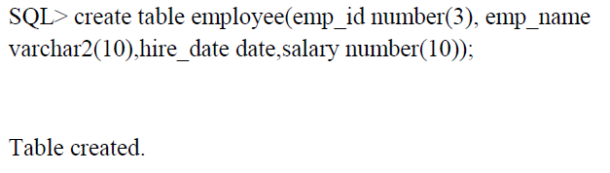
Examples

Slide 16
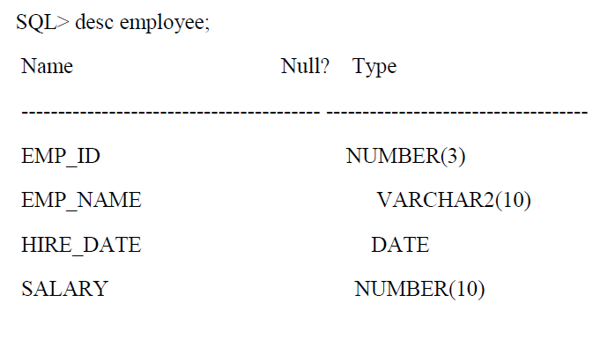
Examples

Slide 17
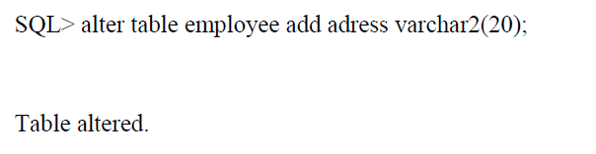
Examples

Slide 18

Examples

Slide 19
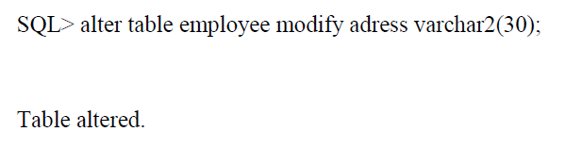
Examples

Slide 20
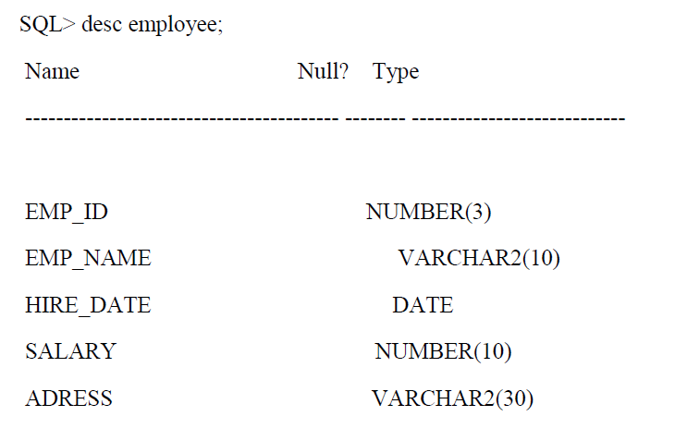
Examples

Slide 21
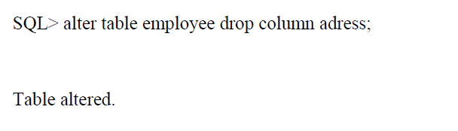
Examples

Slide 22

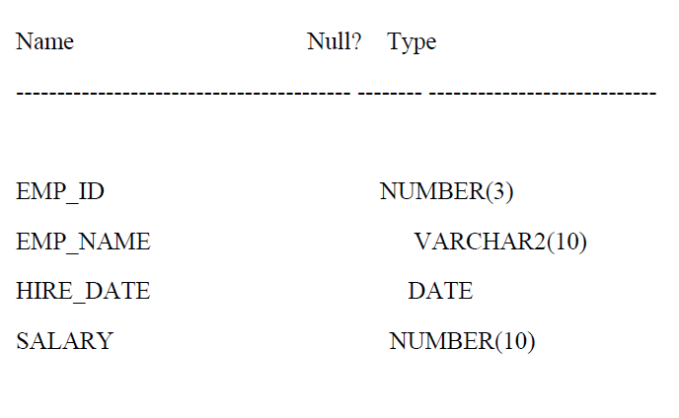
Examples

Slide 23
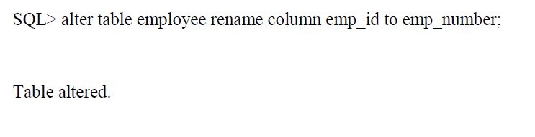
Examples

Slide 24
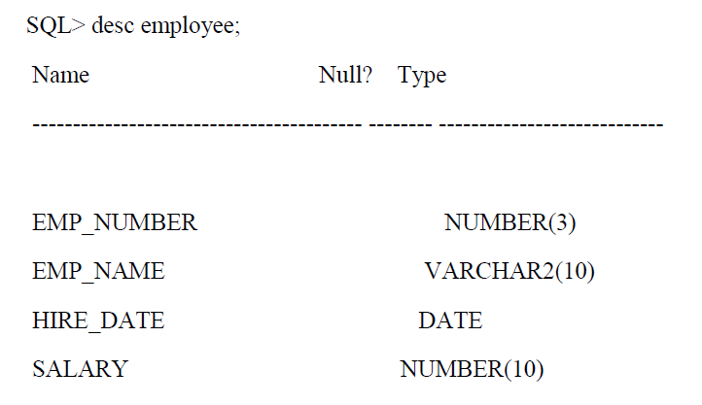
Examples

Slide 25
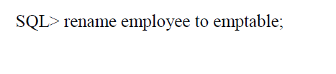

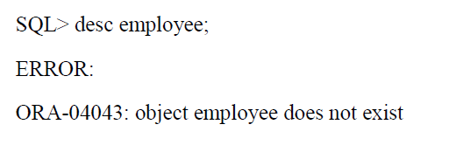
Examples

Slide 26
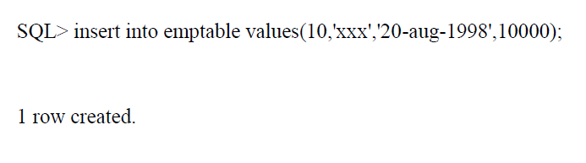
Examples

Slide 27
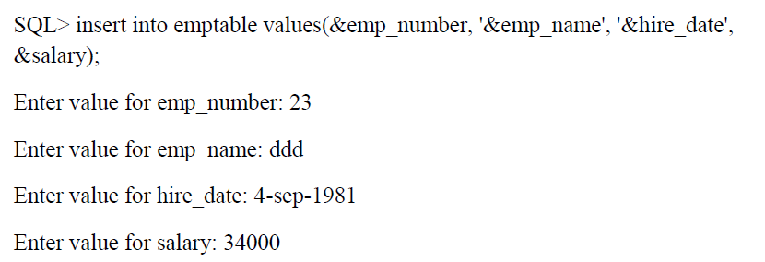
Examples

Slide 28
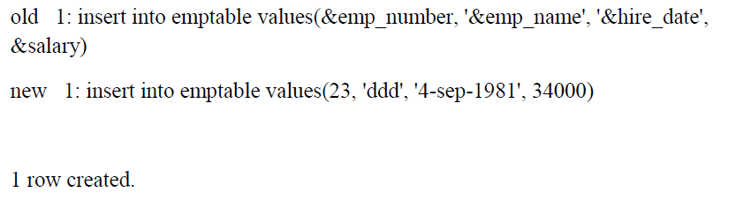
Examples

Slide 29
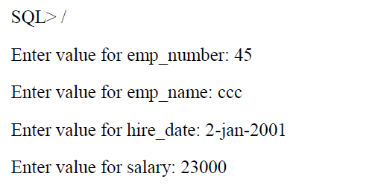
Examples

Slide 30

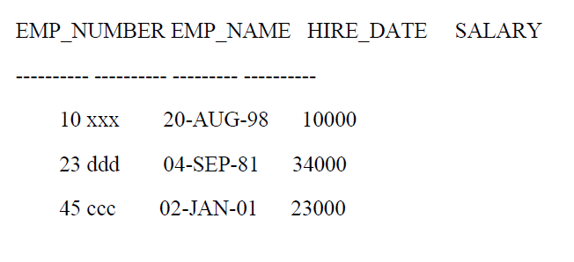
Examples

Slide 31
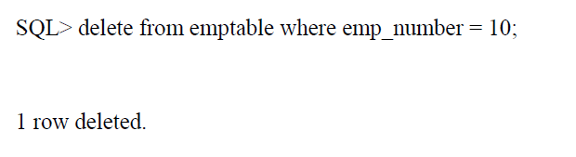
Examples

Slide 32
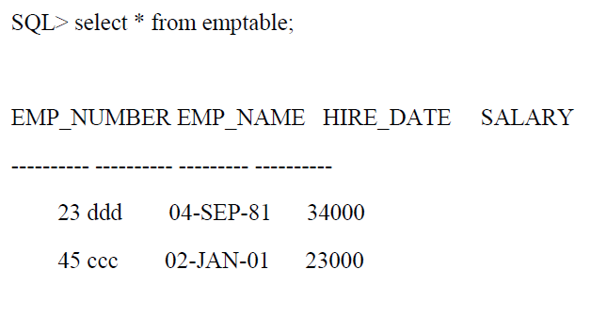
Examples

Slide 33
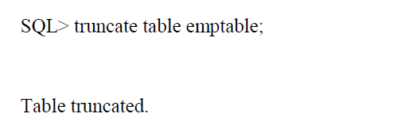
Examples

Slide 34
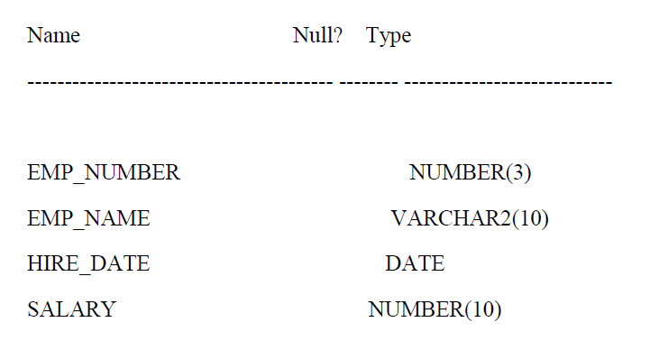
Examples

Slide 35
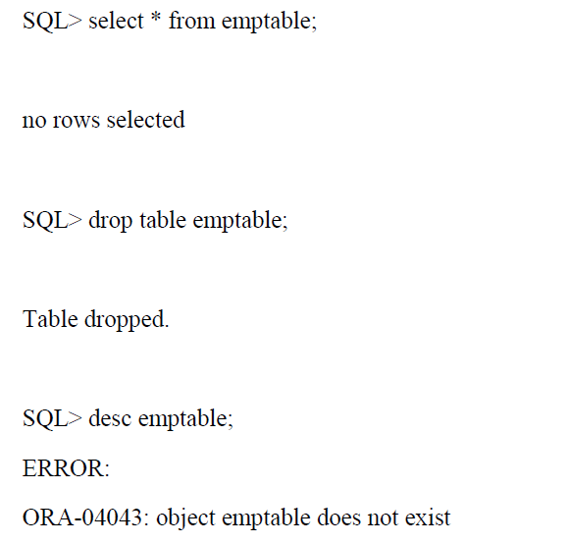
Examples

